Slide 1
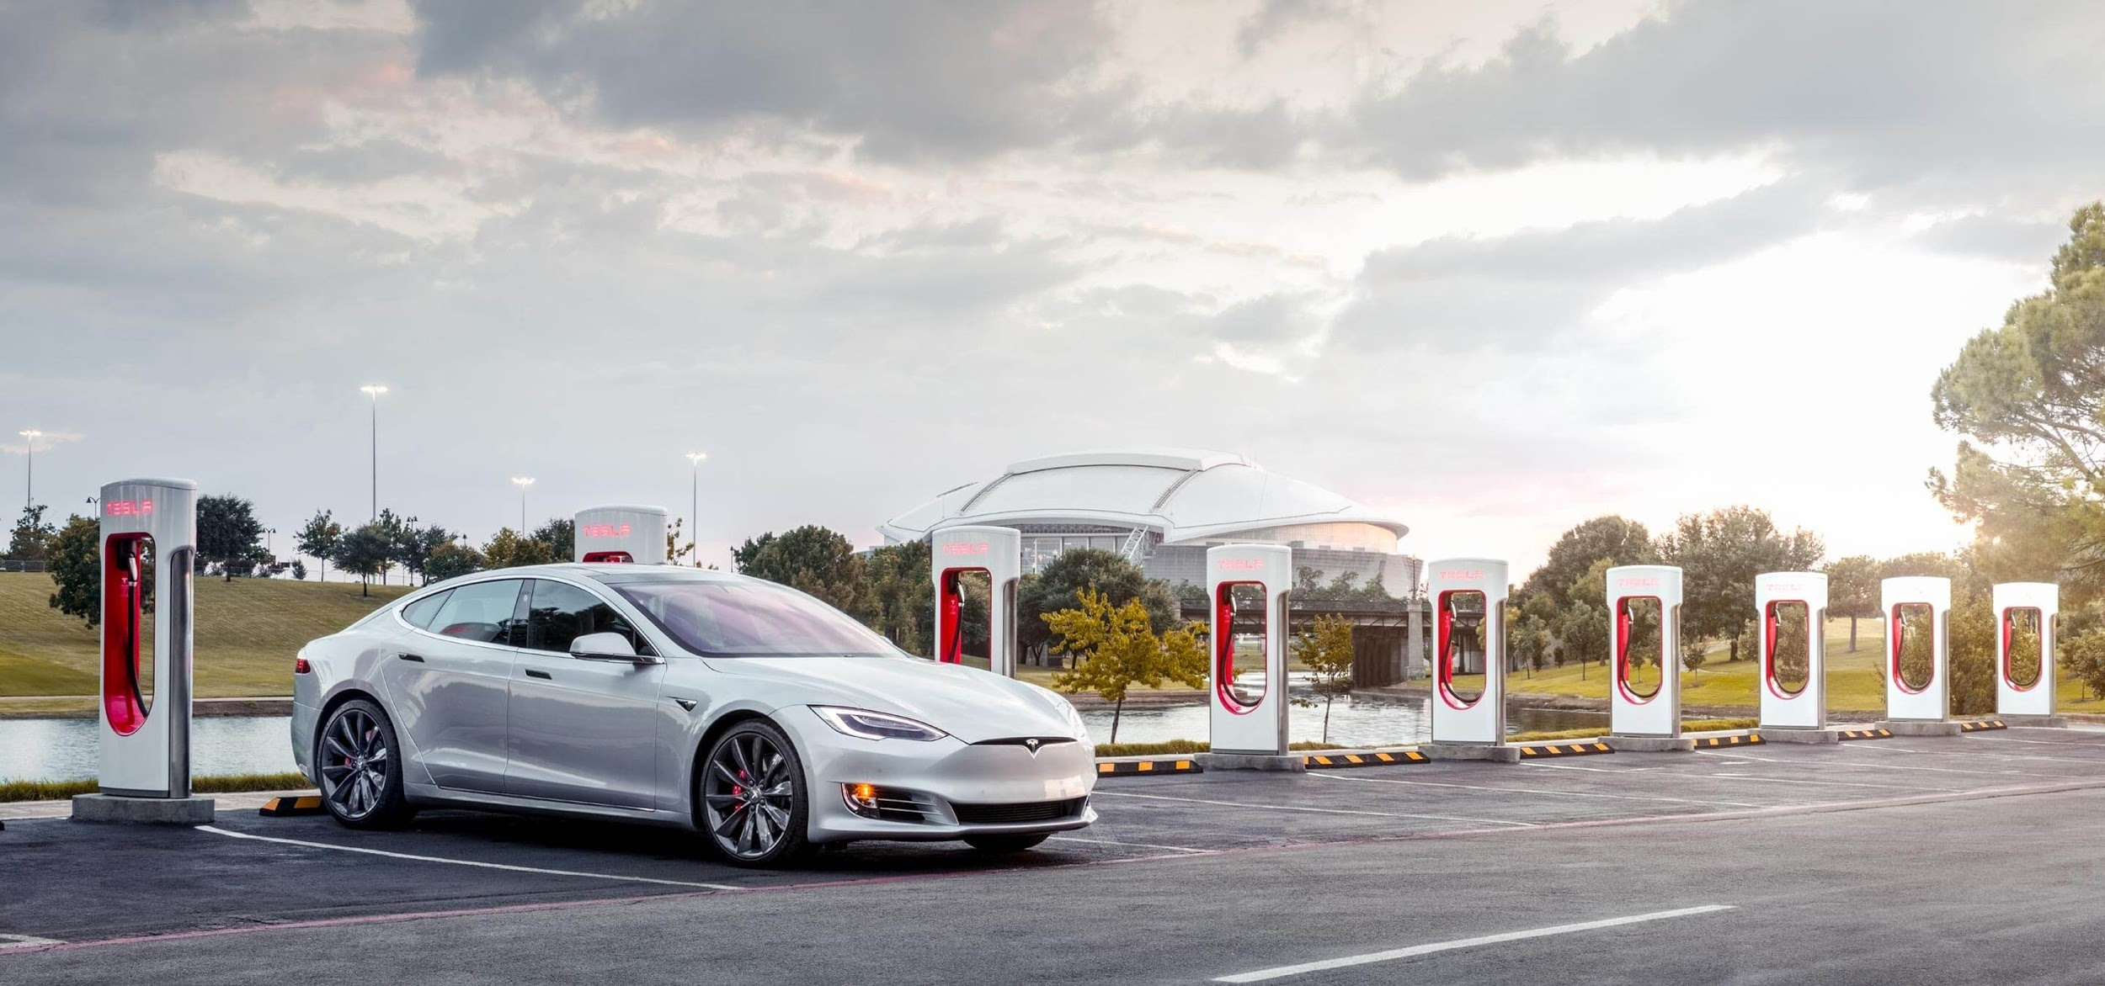
Mapping Tesla Superchargers in the U.S.
Group 1: Ashley Ziur, Shoshone Smith, Wesley Marshall, Zach Carlson
Notes:
Ashley

Slide 2
AGENDA
Project Overview
Why Tesla
Why are Electric Vehicles on the Rise
Who can Benefit
Code Concept
Code Design
Code Explanation
Code Results
How to Run the Verifier
Known Limitations of Project
Potential Future Development
Notes:
Ashley

Slide 3
AGENDA
Project Overview
Why Tesla
Why are Electric Vehicles on the Rise
Who can Benefit
Code Concept
Code Design
Code Explanation
Code Results
How to Run the Verifier
Known Limitations of Project
Potential Future Development
Notes:
Wesley

Slide 4
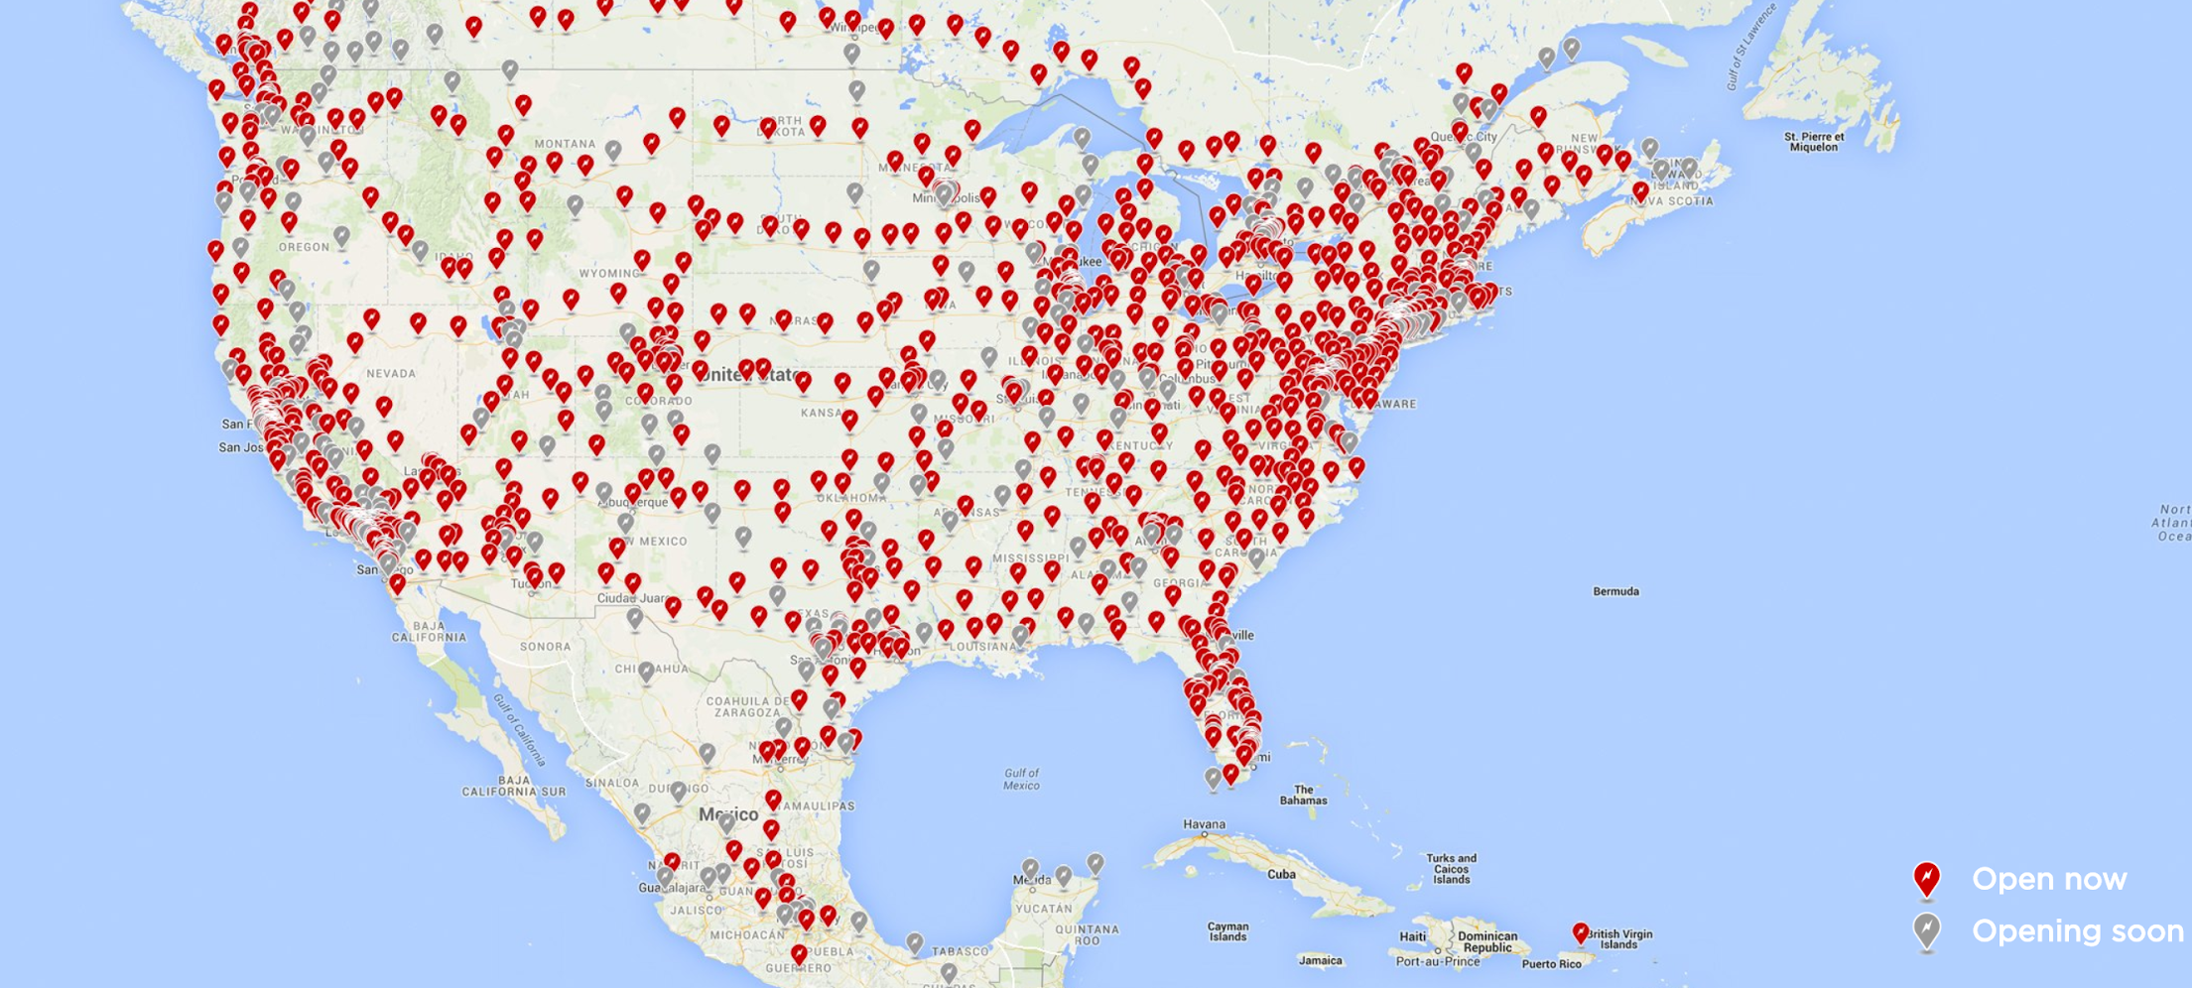
PROJECT OVERVIEW
Scrape Tesla’s website for Supercharger locations
Limited to only the U.S.
Create a .csv file of these data points.
Contains new and upcoming addresses
Compare our Tesla dataset with a Federal dataset
TESLA SUPERCHARGERS IN THE U.S.
Notes:
Wesley

Slide 5
AGENDA
Project Overview
Why Tesla
Why are Electric Vehicles on the Rise
Who can Benefit
Code Concept
Code Design
Code Explanation
Code Results
How to Run the Verifier
Known Limitations of Project
Potential Future Development
Notes:
Wesley

Slide 6

WHY TESLA?
Electric cars have been gaining popularity
Tesla is the leader in the field of electric cars
The majority of charging locations are Tesla locations
Limited locations options for Tesla
Notes:
Wesley

Slide 7
AGENDA
Project Overview
Why Tesla
Why are Electric Vehicles on the Rise
Who can Benefit
Code Concept
Code Design
Code Explanation
Code Results
How to Run the Verifier
Known Limitations of Project
Potential Future Development
Notes:
Ashley

Slide 8


WHY ARE ELECTRIC CARS ON THE RISE?
There are many reasons why people opt for electric vehicles
Some reasons being:
Ability to save money in the long-term
The growing concern for the environment
Notes:
Ashley
ability to save money in the long-term due to the longevity and low maintenance required for electric vehicles in comparison to fuel vehicles.
the growing concern for the environment. Many individuals that are concerned about the harmful emissions released into the environment have opted for a vehicle with a lesser carbon footprint.

Slide 9
AGENDA
Project Overview
Why Tesla
Why are Electric Vehicles on the Rise
Who can Benefit
Code Concept
Code Design
Code Explanation
Code Results
How to Run the Verifier
Known Limitations of Project
Potential Future Development
Notes:
Wesley

Slide 10
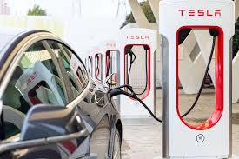
WHO CAN BENEFIT?
Our target audience is Tesla consumers and prospective business partners
Personal usage:
Most up-to-date information regarding Superchargers.
Commercial usage:
Businesses can consider using this data to figure out the closest charging locations
Notes:
Wesley
Personal usage:
Those that are interested in purchasing a Tesla can use this project to get the most up-to-date information regarding Superchargers.
Commercial usage:
Businesses can consider using this data to figure out the closest charging locations and help with other analytic decision making for investment opportunities.

Slide 11
AGENDA
Project Overview
Why Tesla
Why are Electric Vehicles on the Rise
Who can Benefit
Code Concept
Code Design
Code Explanation
Code Results
How to Run the Verifier
Known Limitations of Project
Potential Future Development
Notes:
Ashley

Slide 12
INITIAL CODE CONCEPT
Inspect website HTML code
Convert to JSON
Extract charger locations
Validate dataset
Notes:
Ashley

Slide 13
CODE DESIGN
Developed using Python 3.8 and Jupyter Notebooks
Three Notebooks:
README
Final_project.ipynb
Tesla Scraping
Database_Checker.ipynb
Dataset Comparison
Notes:
Shoshone/Zach

Slide 14
CODE EXPLANATION: final_project.ipynb
Tesla Scraping
Using Request module to download webpages
Inspected the HTML using Beautifulsoup
Using soup to get a list of street addresses
Pre-process our list to prepare turning into dictionaries
Combine all dictionaries
Write out to a CSV file for checker program
Notes:
Shoshone/Zach

Slide 15
CODE EXPLANATION: Database_Checker.ipynb
Define functions to help with searching datasets
City_search
Zipcode_search
State_search
Db_search - Print menu options
Load in both CSV files.
The Federal dataset
The Tesla Supercharger
Get user input
Continue looping until user halt
Print results
Notes:
Shoshone/Zach

Slide 16
CODE RESULTS
Tesla Scraping:
Write out of a CSV file of Tesla Superchargers
Dataset Comparison:
Program that output addresses and charger count
Notes:
Shoshone/Zach

Slide 17
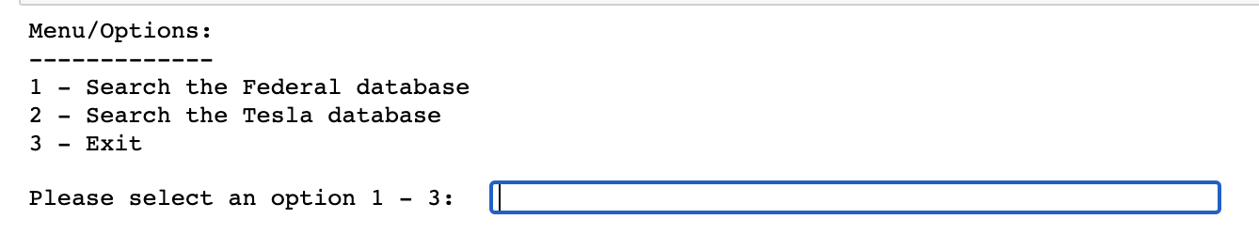
HOW TO RUN THE VERIFIER
Tesla Scraping Section:
Run each cell block under Tesla Scraping Section
Dataset Checker:
Run all cells
Enter input based on options
Notes:
Shoshone/Zach

Slide 18
Demo

Slide 19
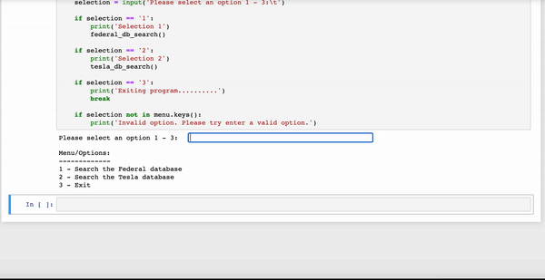
VERIFIER DEMO - Federal
Notes:
Shoshone/Zach

Slide 20
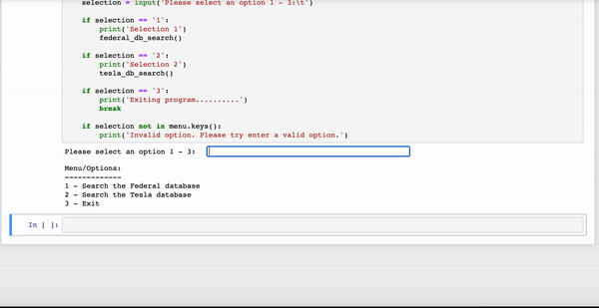
VERIFIER DEMO - Tesla
Notes:
Shoshone/Zach

Slide 21
AGENDA
Project Overview
Why Tesla
Why are Electric Vehicles on the Rise
Who can Benefit
Code Concept
Code Design
Code Explanation
Code Results
How to Run the Verifier
Known Limitations of Project
Potential Future Development
Notes:
Wesley

Slide 22
KNOWN LIMITATIONS OF THE PROJECT
Limited to Tesla Superchargers
Excludes other types of Tesla chargers
Excludes other electric vehicles
Federal dataset is timedated from October 4th 2020
If one wants newer data, must download and update code
Checker function is limited to inputs
Inputs: State, City, and Zip Code
Limited to one dataset at a time
Comparison between datasets must be manual
Notes:
Wesley

Slide 23
AGENDA
Project Overview
Why Tesla
Why are Electric Vehicles on the Rise
Who can Benefit
Code Concept
Code Design
Code Explanation
Code Results
How to Run the Verifier
Known Limitations of Project
Potential Future Development
Notes:
Ashley

Slide 24
POTENTIAL FUTURE DEVELOPMENT
Addition of more advanced result filtering
Expanding to other locations besides the United States
Expanding the scope of the project to account for non-Tesla vehicles.
Notes:
Ashley
Embed Tesla HTML link in Database_Checker addresses
Adding a GUI for the project

Slide 25
THANK YOU!

